Slide 1

Hacking CCTV Cameras
(how, why, movies suck)
By: Dennis Freyman
Cybersecurity Club 2025-2026

Slide 2
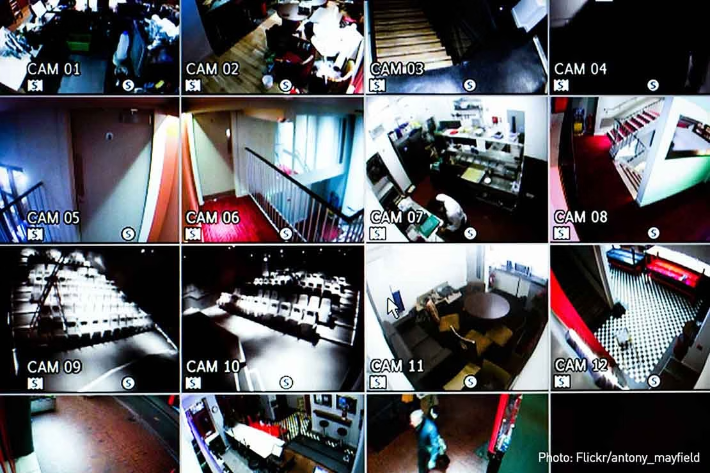

Slide 3
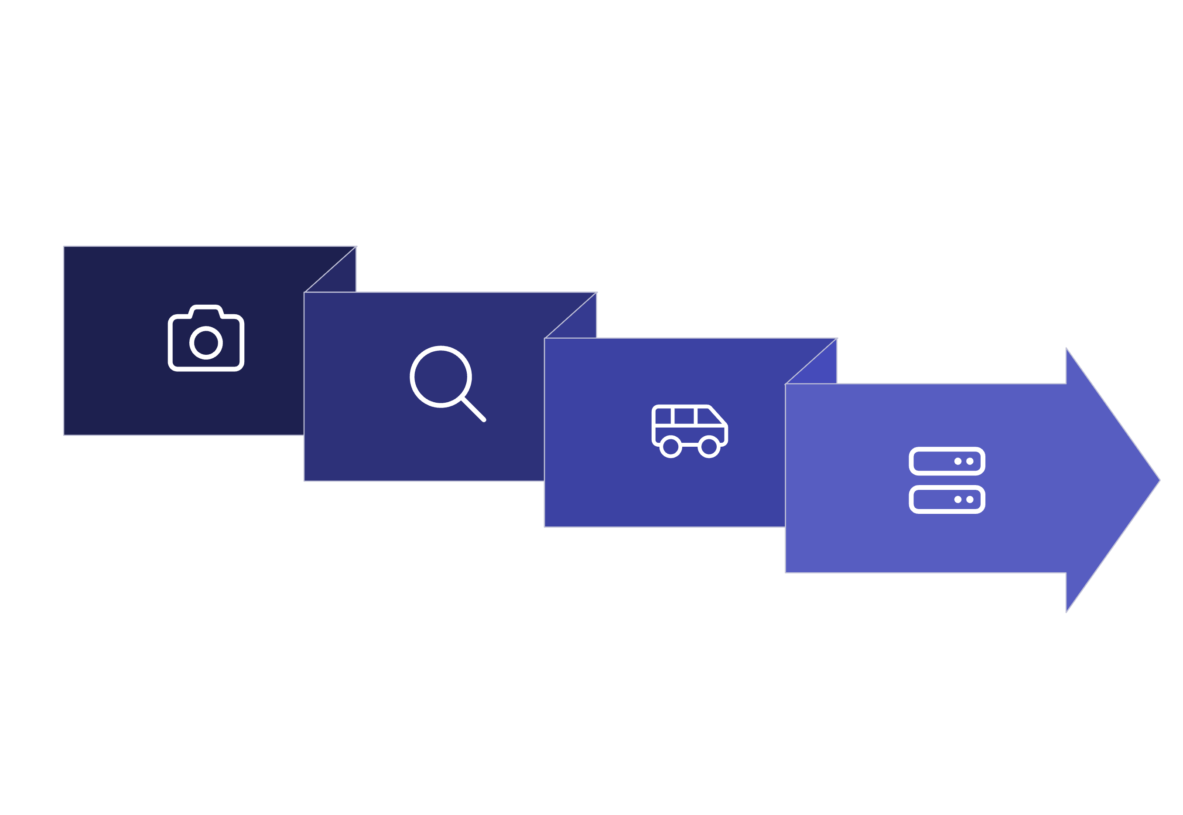




CCTV System Architecture:
PoE Switch
NVR / VMS
IP Camera
VLAN Segmentation

Slide 4
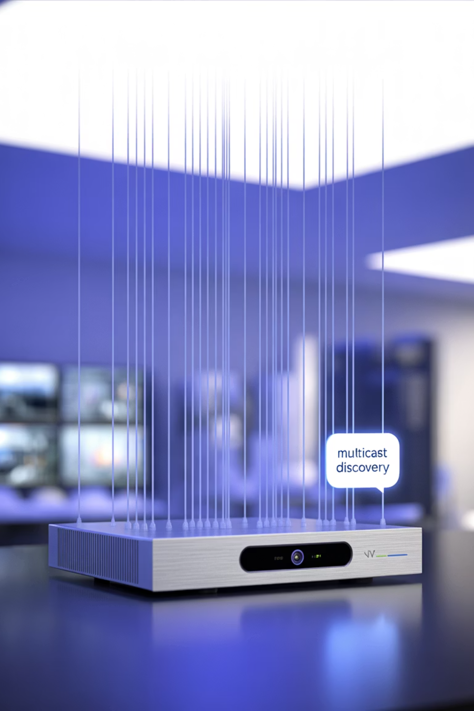
Protocols & Network Structure
ONVIF: The Discovery Protocol
RTP/RTSP: The Streaming Protocol
(Open Network Video Interface Forum)- UDP
(Real-Time Streaming Protocol)-rarely UDP usually TCP

Slide 5
ACLs: What are they and why they make stuff hard
(or easy but thats boring)
PERMIT Rules
DENY Rules
LOGGING & MONITORING
NVR to Cameras: TCP/554 for RTSP control
Users to Cameras: All direct access blocked
Log all dropped connections for analysis
UDP/TCP media ports as needed for video streams
Cameras to Internet: All traffic except vendor update endpoints
Monitor for unauthorized discovery attempts
ONVIF management only from designated NVR management IP
Block UDP 3702 across Layer 3 boundaries (prevents multicast discovery)
Alert on policy violations
No UPnP or NAT-PMP on network gateways

Slide 6

Is it hackable

Slide 7

Attack 1: Cloud and P2P
The P2P Problem
outbound TLS make everything more complicated
lots of shit can happen in between
examples :
Identity/Token issues
Relay/service vuln by vendor
Client sprawl
A notable example is the ThroughTek Kalay platform vulnerability that potentially allowed unauthorized access to video and audio streams from unpatched devices. The vulnerability affected millions of IoT devices worldwide.vulnerability
theres a CVE but i really dont feel like finding it

Slide 8
Attack 2: Firmware and Supply Chain
this is the stuff the movies claim
examples:
on device bugs allowing for stuff like
soap stacks
command injection
buffer overflow
backdoored image mirroring (awesome but hard)
this may also include outdated VMS, outdated servers, etc,etc,etc,etc
update ur stuff guys

Slide 9
1
2
Device-Level Vulnerabilities
Platform-Scale Breaches
Hikvision CVE-2021-36260 (i found the cve guys) exemplified how command injection vulnerabilities in camera web servers can provide complete device compromise. Attackers could execute arbitrary commands with root privileges simply by sending crafted HTTP requests. Present in est. 15mil active devices.
The 2021 Verkada breach demonstrated how centralized cloud platforms amplify risk. Attackers gained access to over 150,000 cameras across hospitals, schools, and businesses through a single platform compromise, which hit EoL.

Slide 10
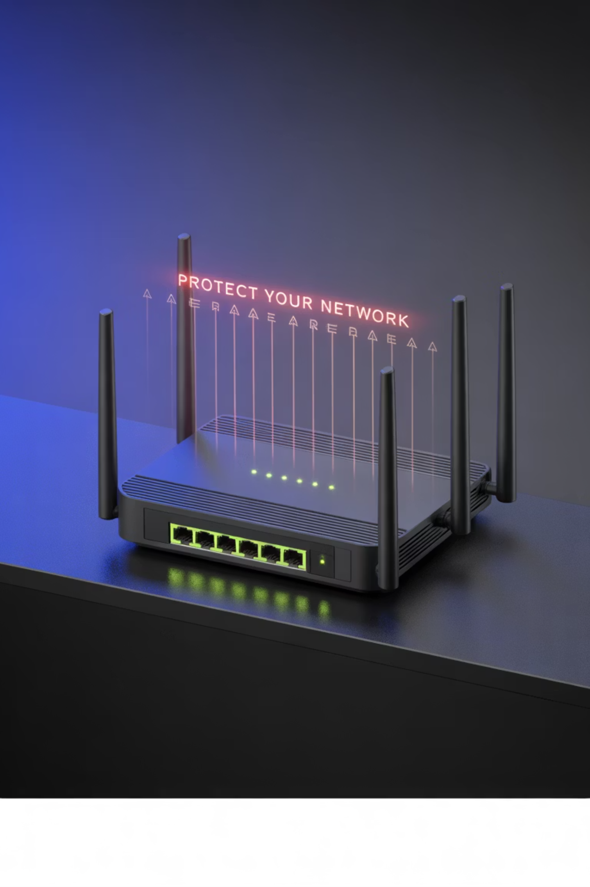
Attack 3: NAT-PMP/UPnP
(Universal Plug and Play) and (Network Address Translation Port Mapping Protocol)
basically the idea of automated ACLs and Port opening for user conviencence
security has inverse relationship with convenience
exposed ACLs lead to attack vectors 1/2

Slide 11
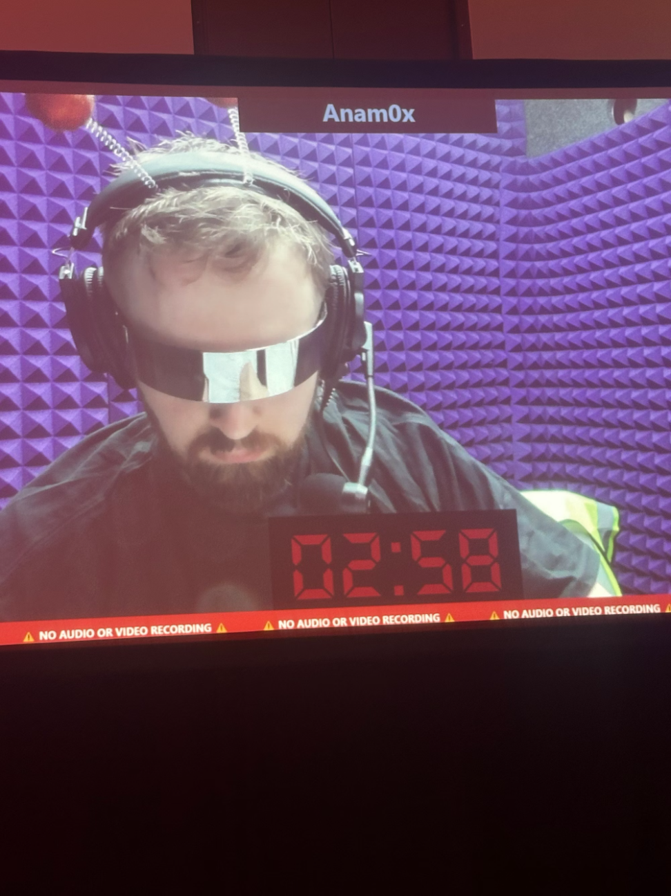
Attack 4: HUMANS ARE ALWAYS THE PROBLEM
defcon funny storytime
https://x.com/anam_x0

Slide 12

Security Checklist: Building CCTV Like a Professional
1
Network Segmentation
2
Access Control Template
3
Security Fundamentals
Deploy dedicated IoT-Cams VLAN with one designated NVR management IP. No exceptions.
Allow NVR→Cams on required ports only. Deny Users→Cams completely. Block Cams→Internet except vendor updates. Block UDP 3702 across subnets to prevent discovery abuse.
Regular patching, unique credentials, MFA on NVR/cloud access, UPnP disabled, comprehensive logging to SIEM, and planning for firmware signing and certificate management.
The Reality: Properly configured CCTV systems are boring and secure. Movie-style hacking requires either gross misconfiguration or insider access - not superhuman typing skills.

Slide 13
Thanks for coming guys registration do it and join groupme pls and ty

